Slide 1
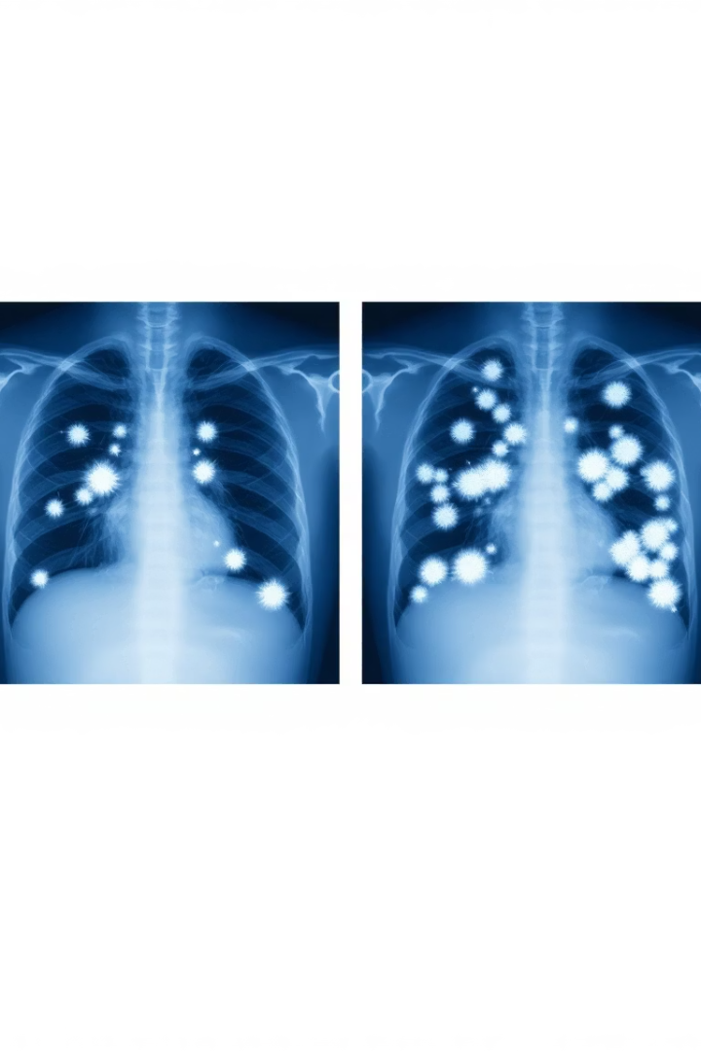
COVID-19 Diagnosis Using Chest X-Ray Images
To develop an automated system for COVID-19 diagnosis using chest Xray images by leveraging image processing and deep learning techniques.
COVID-19 is a global pandemic, and rapid diagnosis is critical for effective treatment and containment. Chest X-rays are a cost-effective and widely available diagnostic tool.
Use a dataset of chest X-ray images (COVID-19, Normal, Viral Pneumonia, and Lung Opacity) and apply pre-processing techniques followed by a deep learning model for classification.

Slide 2

Problem Statement / Domain
Manual Diagnosis Challenges
Domain
Challenges
Manual diagnosis of COVID-19 from chest Xrays is time-consuming and prone to human error. There is a need for an automated, accurate, and efficient system to assist medical professionals.
Medical imaging, specifically chest X-ray analysis, for COVID-19 detection.
Variability in X-ray image quality
Class imbalance in the dataset
Distinguishing COVID-19 from other lung infections (e.g., Viral Pneumonia, Lung Opacity)

Slide 3
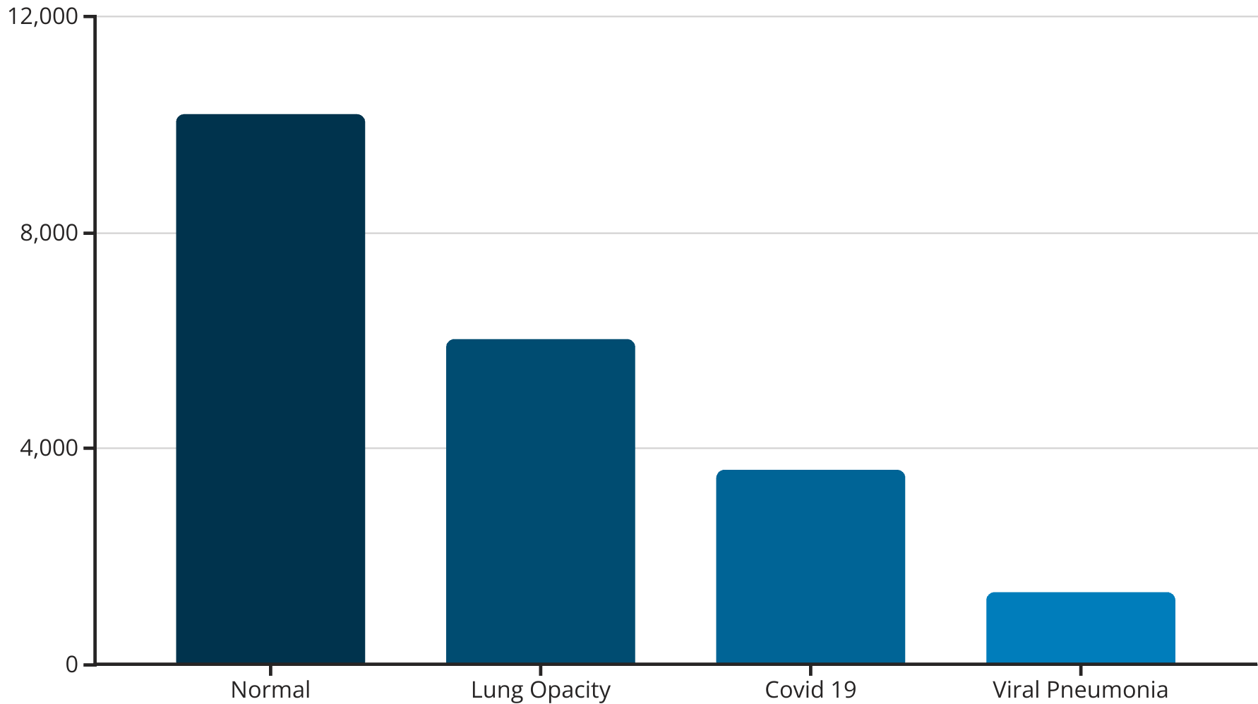
Dataset Description
The dataset contains chest X-ray images across four categories: Normal (10192 images), Lung Opacity (6012 images), COVID-19 (3616 images), and Viral Pneumonia (1345 images). This distribution shows a significant class imbalance that needs to be addressed during model training.

Slide 4
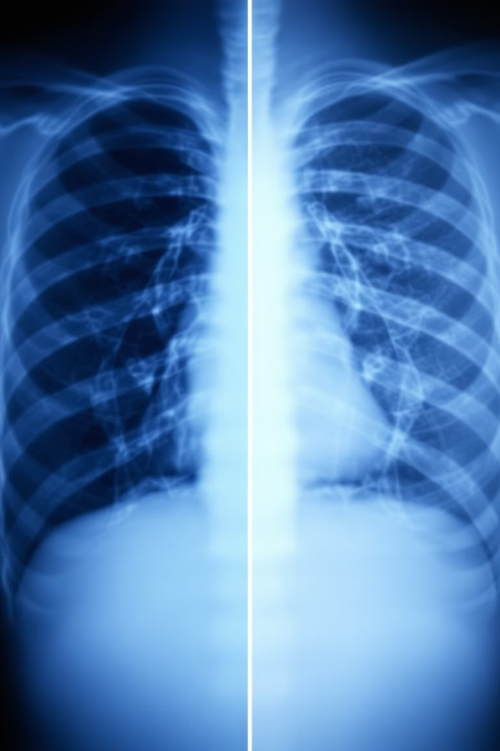
Pre-processing Techniques - Image Enhancement
Histogram Equalization (HE)
Used to improve the brightness and contrast of grayscale images by spreading out intensity level.
Contrast Limited Adaptive Histogram Equalization (CLAHE)
Applied to improve local contrast adaptively by operating on small tiles. This prevents noise amplification while enhancing features.
Image Complement
Used to invert grayscale intensity values to simulate diagnostic viewing techniques used by radiologists.
Image Enhancement was performed to improve the quality and contrast of chest X-ray images, making it easier for the deep learning model to identify relevant features.

Slide 5
Pre-processing Techniques - Segmentation and Resizing
Segmentation
Resizing
To extract the region of interest (ROI) using:
All images were resized to a standard resolution of 224×224 pixels using OpenCV to ensure uniform input shape. This resizing was applied to both the segmented and CRF-refined versions of the images.
Ground Truth Lung Masks: Where available, segmentation masks were loaded, resized, and used to isolate the lung region via pixel-wise multiplication
Modified U-Net with CRF Attention: A U-Net model with CRF-inspired attention blocks was constructed to generate masks in the absence of ground truth
DenseCRF Refinement: Applied to enhance segmentation by aligning mask boundaries with image edges and structures

Slide 6
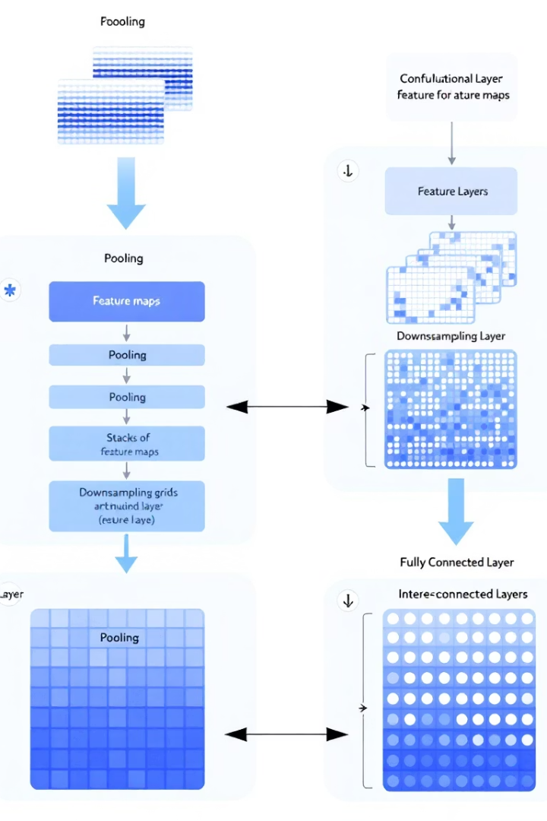




Model Selection and Preparation
Data Preparation
Dataset split into training, validation, and testing sets with appropriate augmentation to address class imbalance
Model Architecture
Selected pre-trained models (VGG19 and EfficientNetB0) and modified them for the specific classification task
Training Configuration
Optimized hyperparameters, learning rate schedules, and loss functions for multi-class classification
Evaluation Metrics
Implemented accuracy, precision, recall, F1-score, and confusion matrix for comprehensive performance assessment

Slide 7
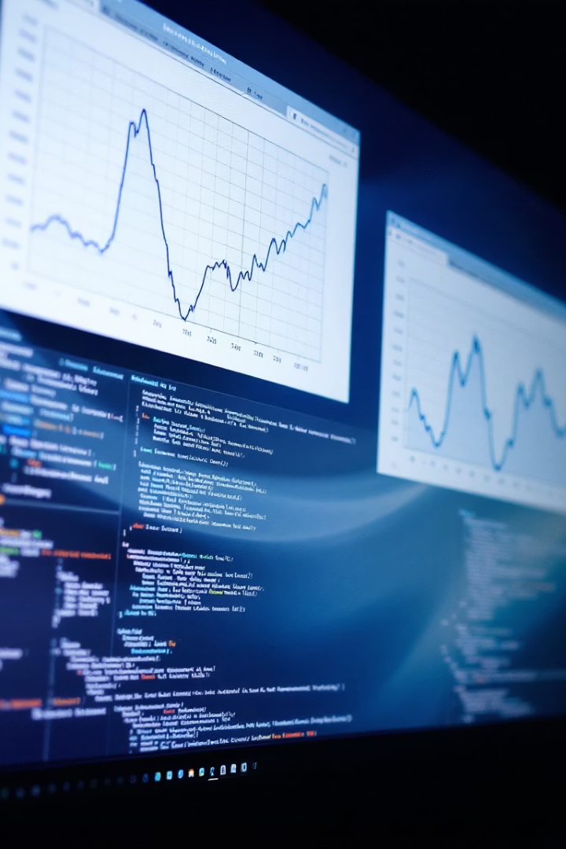




Data Preparation and Training
Data Loading
Load and organize preprocessed X-ray images with class labels
Data Splitting
Split into training (70%), validation (15%), and test (15%) sets
Augmentation
Apply rotations, flips, and shifts to increase dataset diversity
Model Training
Train models with optimized parameters and early stopping
The training process involved careful preparation of the dataset to address class imbalance issues, with appropriate augmentation techniques to enhance model generalization. Multiple models were trained with different configurations to identify the best performing architecture.

Slide 8
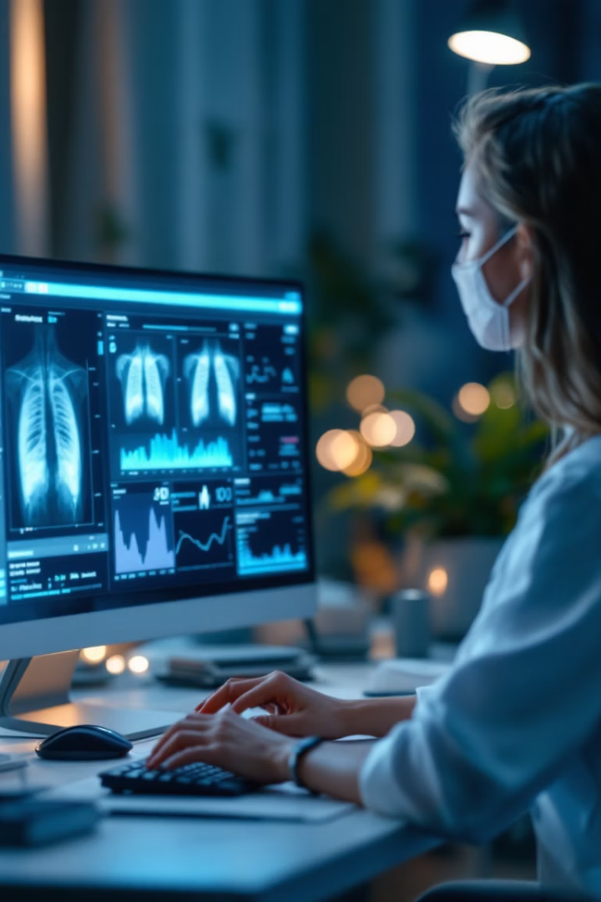




Evaluation and Conclusion
Developed an automated system for COVID-19 diagnosis using chest X-ray images with image processing and deep learning
Applied techniques like Histogram Equalization, CLAHE, and DenseCRF for image enhancement and segmentation
Achieved high accuracy using VGG19 and EfficientNetB0, addressing challenges like class imbalance and variability in image quality
Demonstrated the potential of AI to assist medical professionals in rapid and accurate diagnosis
The developed system shows promising results in automatically diagnosing COVID-19 from chest X-ray images, potentially reducing the burden on healthcare systems and improving diagnostic accuracy and speed during the pandemic.

